Slide 1
OPERATING SYSTEMS CSE 4300
Instructor:Mohammad Maifi Hasan Khan
Chapter 4 File Systems

Slide 2
File Systems (1)
Essential requirements for long-term information storage:
It must be possible to store a very large amount of information.
The information must survive the termination of the process using it.
Multiple processes must be able to access the information concurrently.

Slide 3
File Systems (2)
Think of a disk as a linear sequence of fixed-size blocks and supporting reading and writing of blocks. Questions that quickly arise:
How do you find information?
How do you keep one user from reading another’s data?
How do you know which blocks are free?

Slide 4
File Systems
File Naming
File Types
Regular , Directories, Character special, block special
File Access
Sequential, Random
File Attributes
Protection, Hidden flag, …

Slide 5
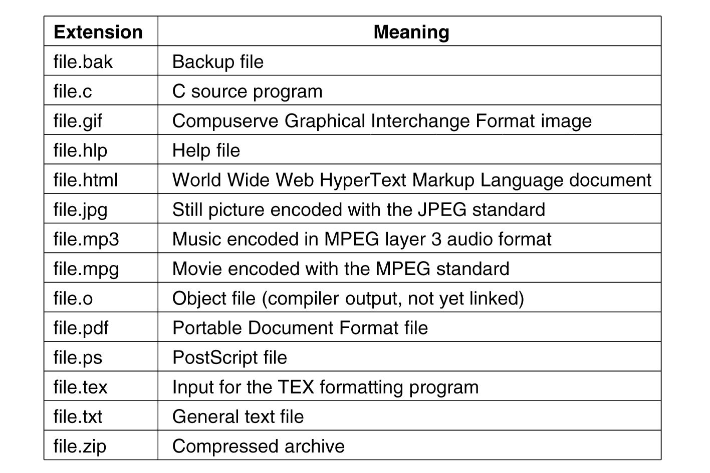
File Naming
Some typical file extensions.

Slide 6
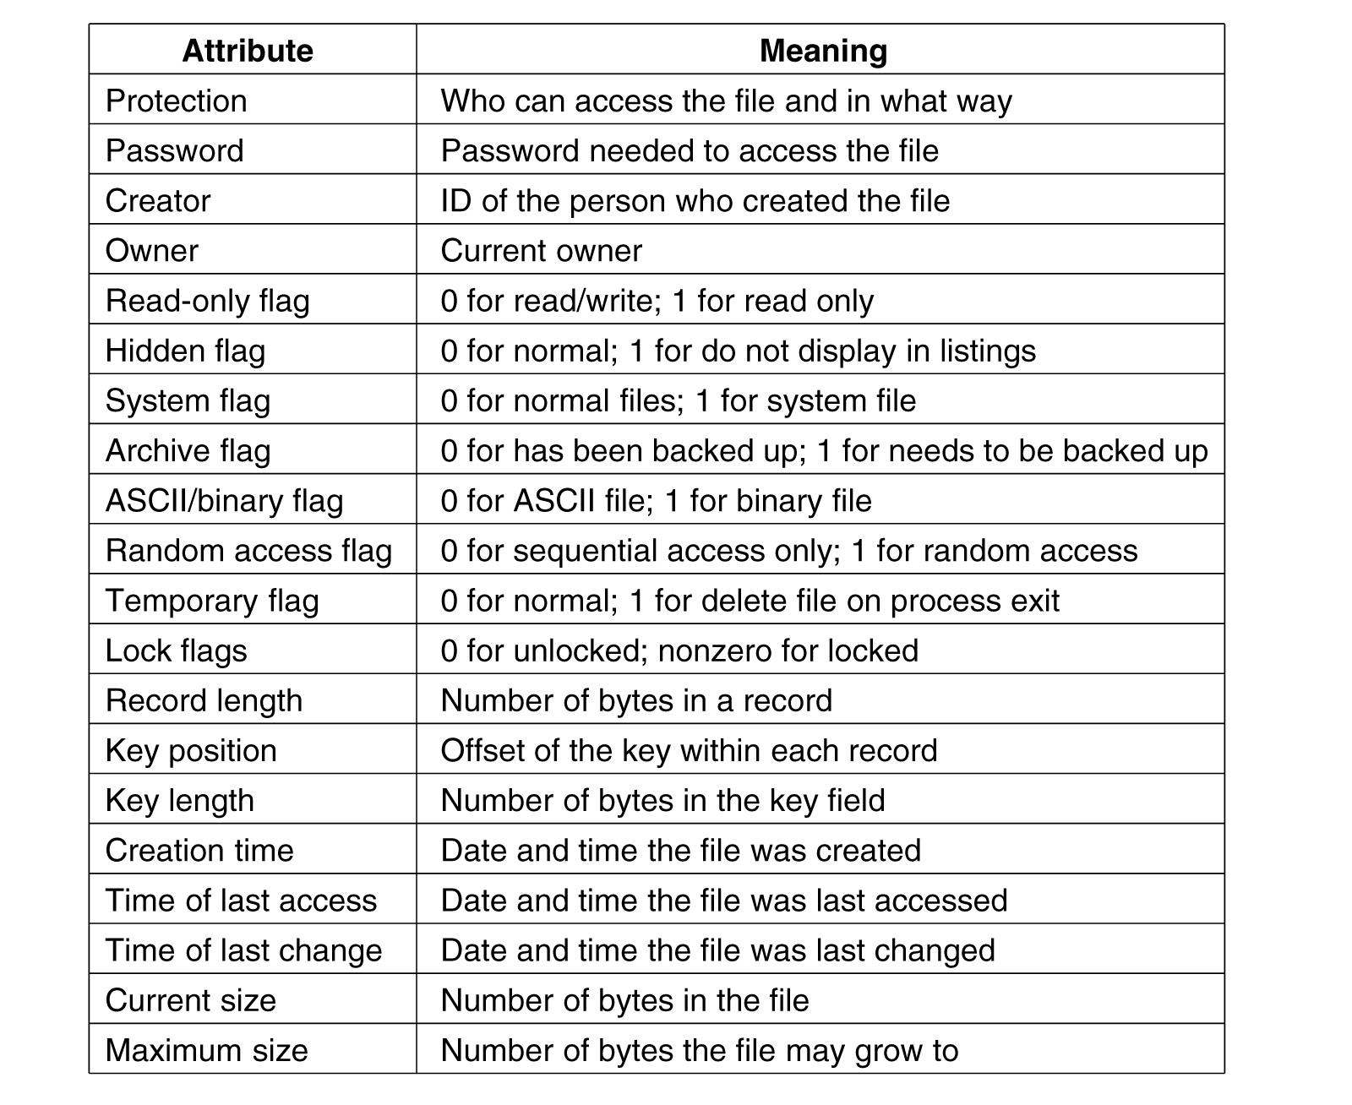
File Attributes
Some possible file attributes.

Slide 7
File Operations
The most common system calls relating to files:
Create
Delete
Open
Close
Read
Write
Append
Seek
Get Attributes
Set Attributes
Rename

Slide 8
Directories
Single-level directory
Hierarchical directory
Path names

Slide 9
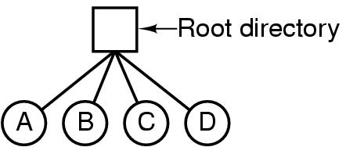
Hierarchical Directory Systems (1)
A single-level directory system containing four files.

Slide 10
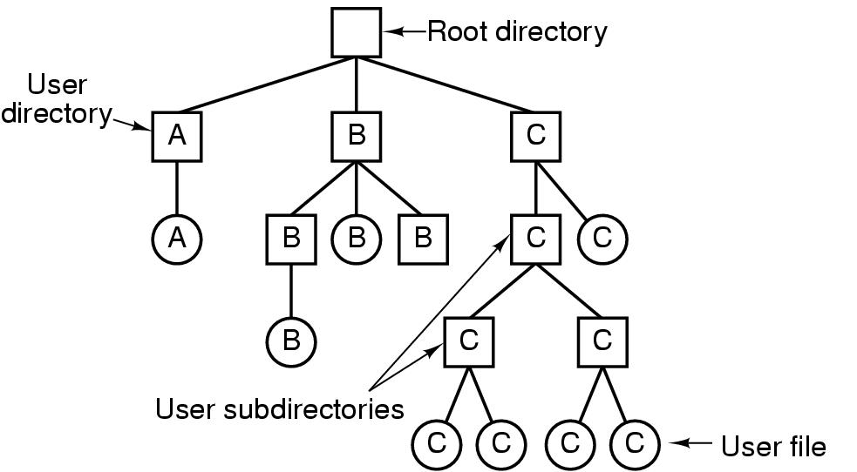
Hierarchical Directory Systems (2)
A hierarchical directory system.

Slide 11
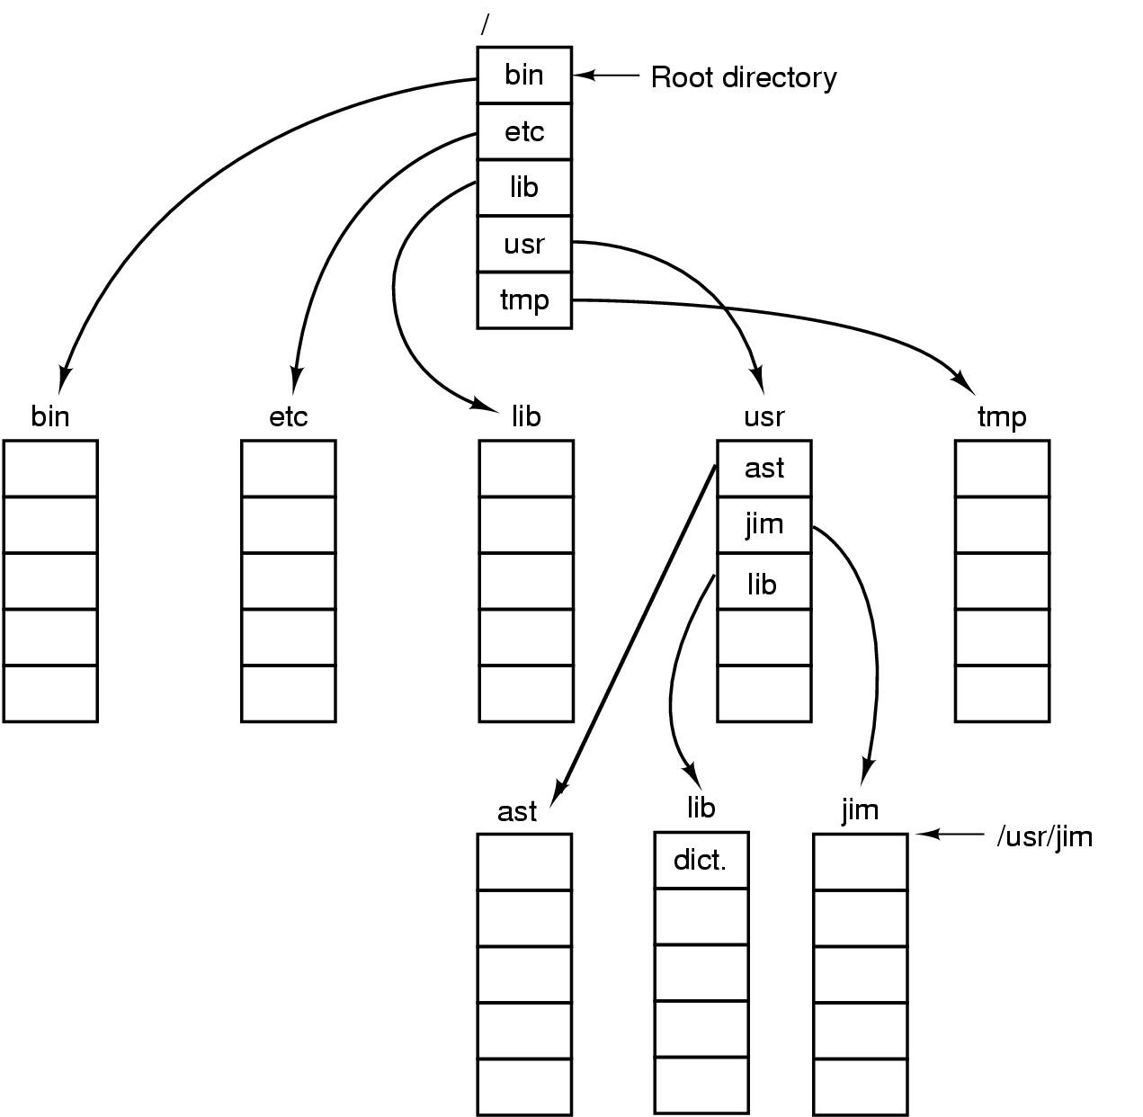
Path Names
A UNIX directory tree.

Slide 12
So Far, User’s view!
Now, how do we implement all these?

Slide 15
File System Layout
MBR – Sector 0
End of MBR contains the partition table
Each partition has independent file system
One partition is marked “Active”
BIOS first execute MBR
MBR program reads first block from active partition, which loads OS
A possible file system layout.

Slide 16
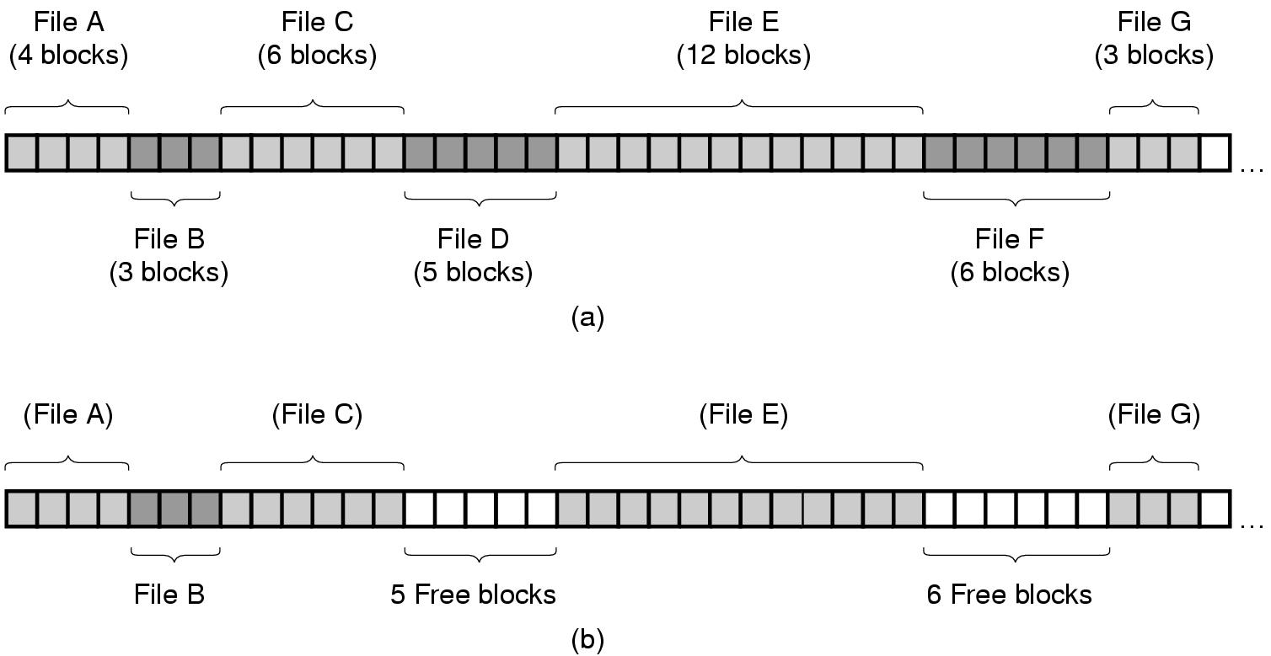
Contiguous Allocation
(a) Contiguous allocation of disk space for 7 files.
(b) The state of the disk after files D and F have been removed.

Slide 17
Contiguous Allocation
Advantages:
Simple to implement
Start disk block and length
Efficient to read back
Disadvantages
Fragmentation
Contiguous allocation is good for CD-Rom!

Slide 18
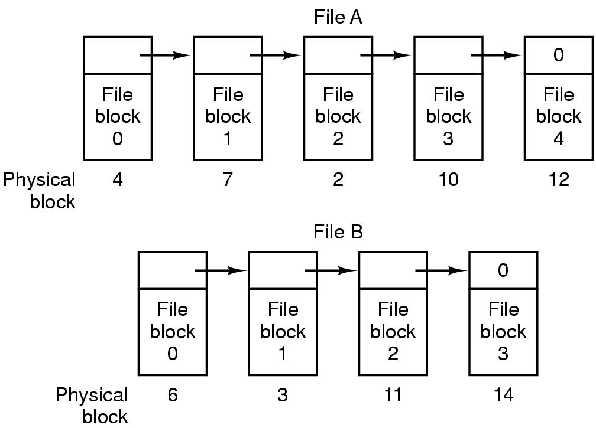
Linked List Allocation
Storing a file as a linked list of disk blocks.

Slide 19
Linked-list Allocation
Advantages:
No space lost due to disk fragmentation (still has internal fragmentation, space lost in the last block!)
Sequential access is straight-forward
Disadvantages
Random access slow
Not a power of 2 any more. May require to read two blocks and merge them manually

Slide 20
Linked List Allocation Using a Table
FAT: Not good for large disk!
For 2 GB disk and 1 KB block size, table needs 200 million entries!
Linked list allocation using a file allocation table

Slide 21
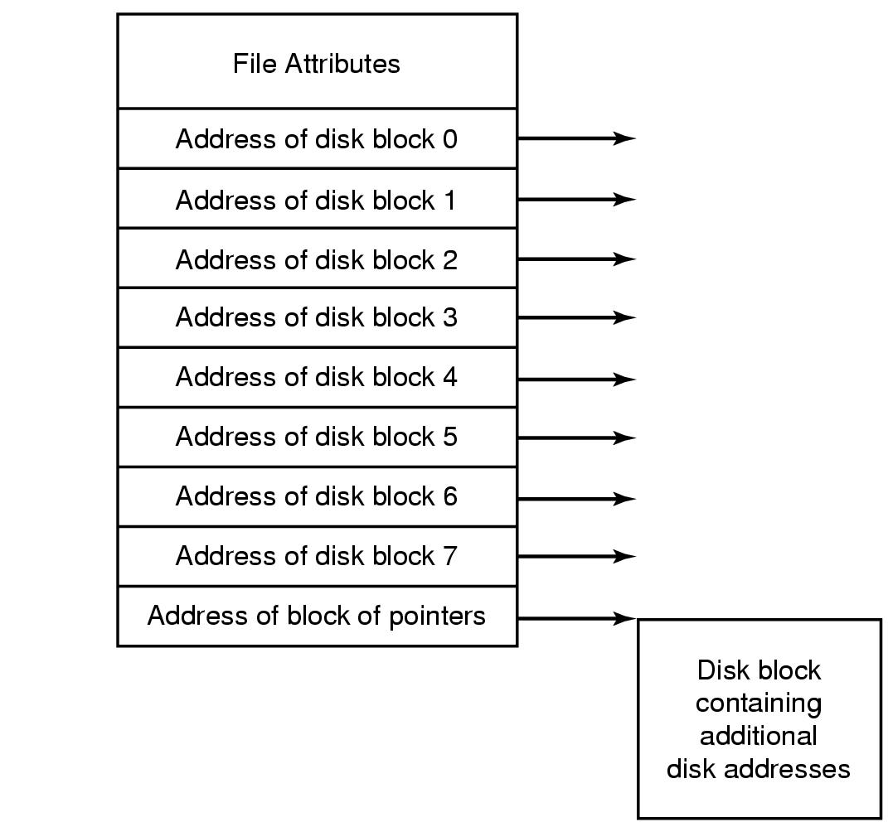
I-nodes
I-node per file:
Needs to be in memory only when the file is open
Size required is proportional to the maximum
number of files that can be open at the same time
I-node structure is fixed. So, what happens when the
file grows?
An example i-node.

Slide 22
I-nodes
I-node per file:
Needs to be in memory only when the file is open
Size required is proportional to the maximum
number of files that can be open at the same time
I-node structure is fixed. So, what happens when the
file grows?
An example i-node.

Slide 23
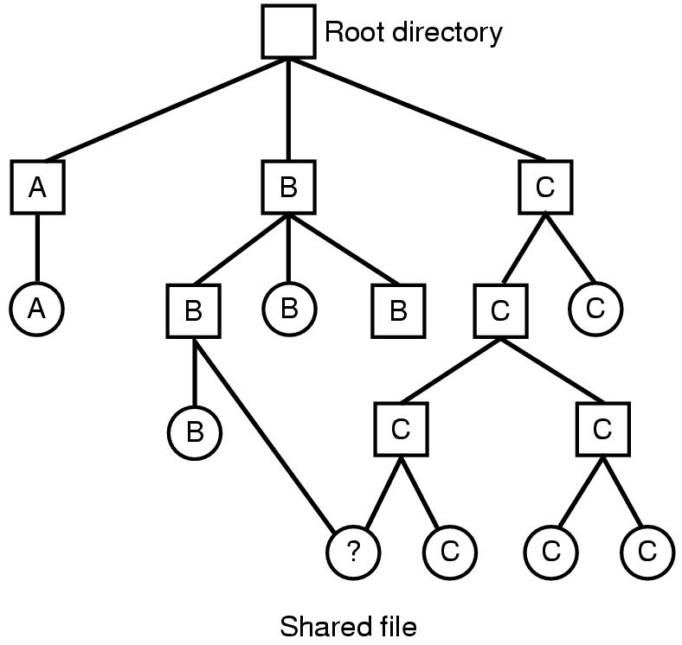
Shared Files (1)
Symbolic Link?
Hard Link?
Restoring from back up?
Link.
Linking allows a file to appear in more than one directory.
Linking that increase the counter in the file’s i-node is called a hard link.
Symbolic link
Instead of having two names point to the same internal data structure representing a file, a name is created that points to a file that includes the name of another file.
Symbolic link can allow to point to files across computers.
File system containing a shared file.

Slide 24
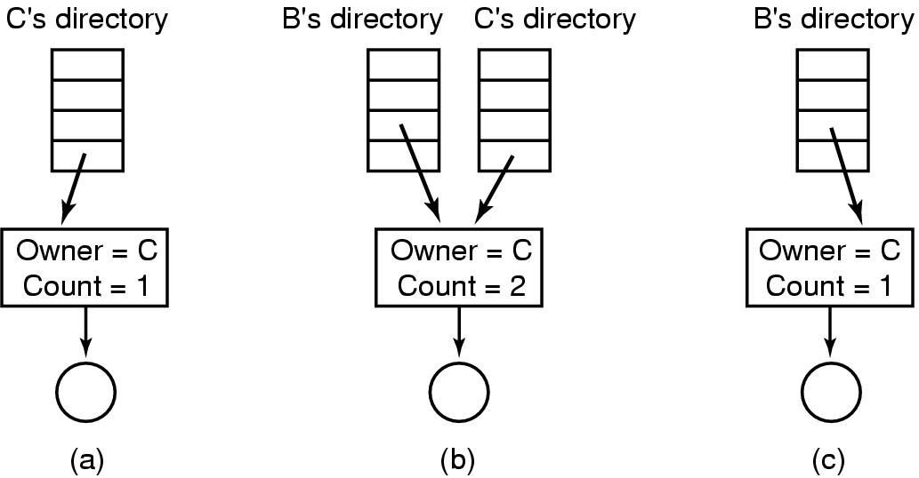
Shared Files (2)
(a) Situation prior to linking. (b) After the link is created. (c) After the original owner removes the file.

Slide 25
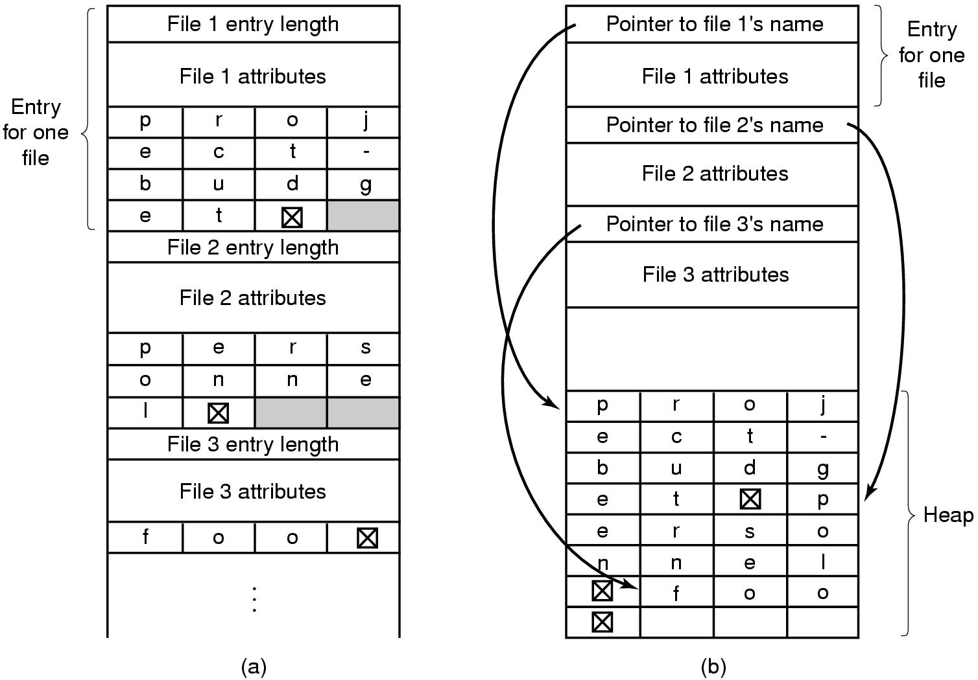
Implementing Directories (2)
Can page fault happen
due to long names?
Two ways of handling long file names in a directory. (a) In-line. (b) In a heap.

Slide 26
Implementing Directories - Challenges
How to efficiently look-up directory names?
Hashing
Hash on file names

Slide 27
Consider a disk with 1 MB per track.
Rotation time of 8.33 msec,
Avg. seek time 5 msec
How long it takes to read a block of k bytes?

Slide 29
Consider a disk with 1 MB per track.
Rotation time of 8.33 msec,
Avg. seek time 5 msec
How long it takes to read a block of k bytes?
5 + 8.33/2 + (k/1024*1024)*8.33
The book uses 1000000 to approximate 1024*1024

Slide 30
Disk Space Management Block Size
Percentage of files smaller than a given size
(in bytes).

Slide 32
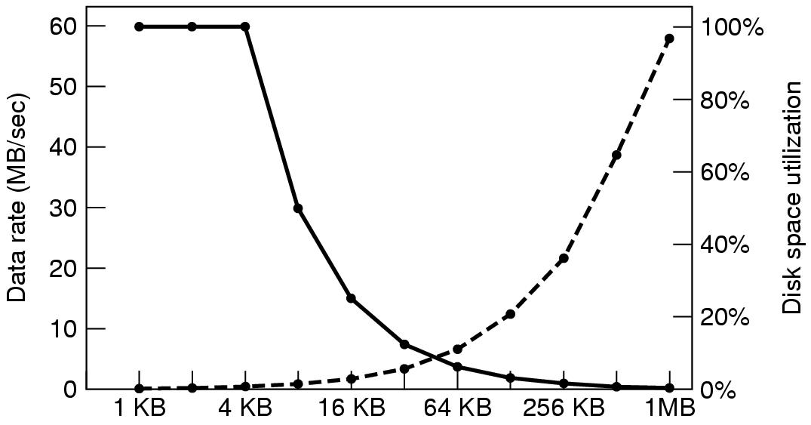
Disk Space Management Block Size (2)
The dashed curve (left-hand scale) gives the data rate of a disk. The solid curve (right-hand scale) gives the disk space efficiency. All files are 4 KB.

Slide 34
Keeping Track of Free Blocks (1)
(a) Storing the free list on a linked list. (b) A bitmap.

Slide 35
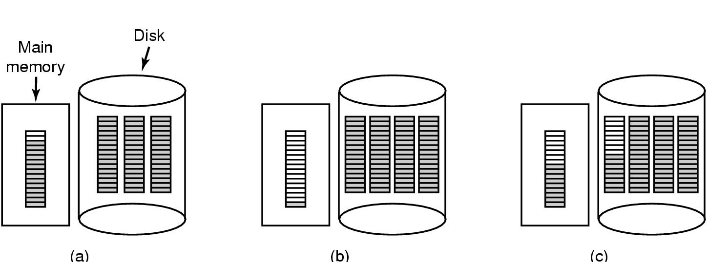
Keeping Track of Free Blocks (2)
(a) An almost-full block of pointers to free disk blocks in memory and three blocks of pointers on disk. (b) Result of freeing a three-block file. (c) An alternative strategy for handling the three free blocks. The shaded entries represent pointers to free disk blocks.

Slide 36
File System Backups (1)
Backups to tape are generally made to handle
Recovery from disaster.
Physical Dump: Dumps everything starting from block 0
Advantage:
Simplicity, great speed
Disadvantage
Inability to skip directories
Inability to make incremental dump
Inability to restore individual files

Slide 37
File System Backups (1)
No value in dumping unused block
Skipping free blocks require to store the block number along with dumped block
What about Bad block?
If disk controller handles transparently, no problem
If maintained by OS, dumping algorithm needs access to that info
Can not restore individual file!
Can not do incremental dump!

Slide 38
Logical Dump

Slide 39
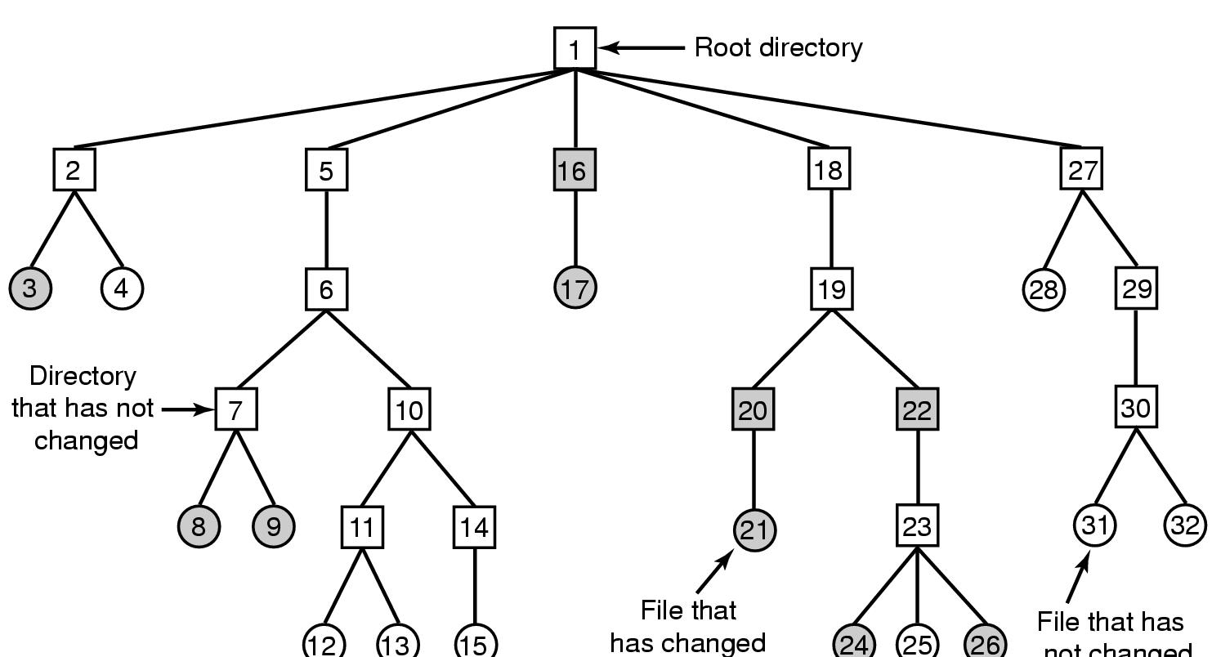
File System Backups (2)
A file system to be dumped. Squares are directories, circles are files. Shaded items have been modified since last dump. Each directory and file is labeled by its i-node number.

Slide 40
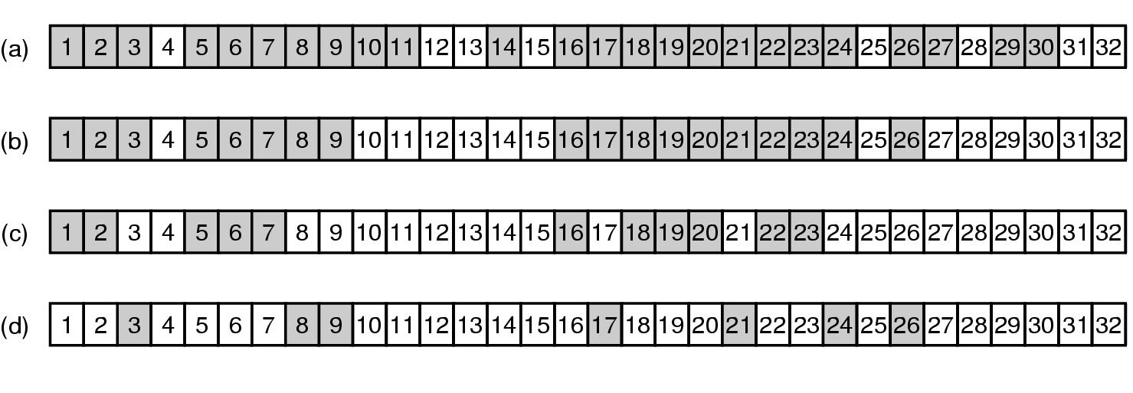
File System Backups (3)
Phase 1: First, start from root directory, Mark all the directories
and modified file in the bitmap
Phase 2: Unmark all directories that has no modified files under it
Phase 3: Dump the remaining directories
Phase 4: Dump the modified files
Bitmaps used by the logical dumping algorithm.

Slide 41
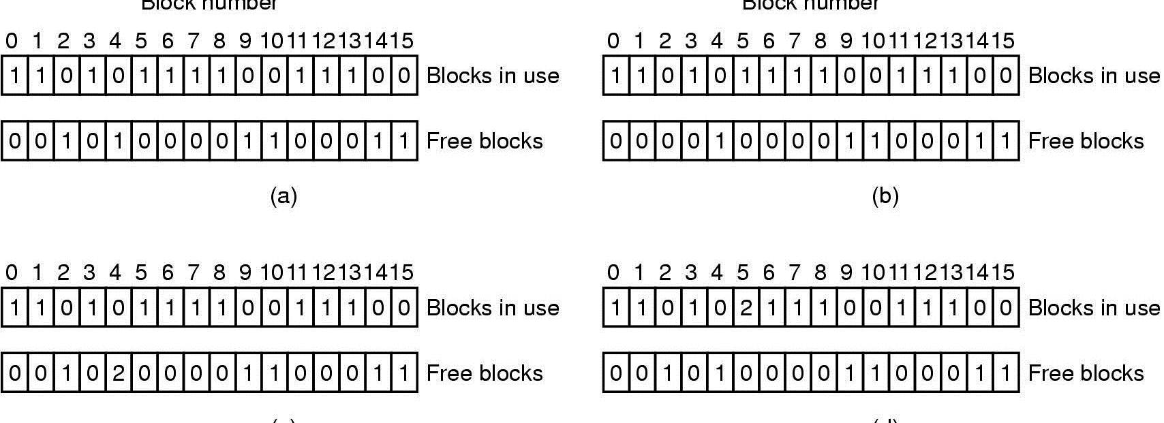
File System Consistency
File system states. (a) Consistent. (b) Missing block. (c) Duplicate block in free list. (d) Duplicate data block.

Slide 42
File System Performance Issues

Slide 43
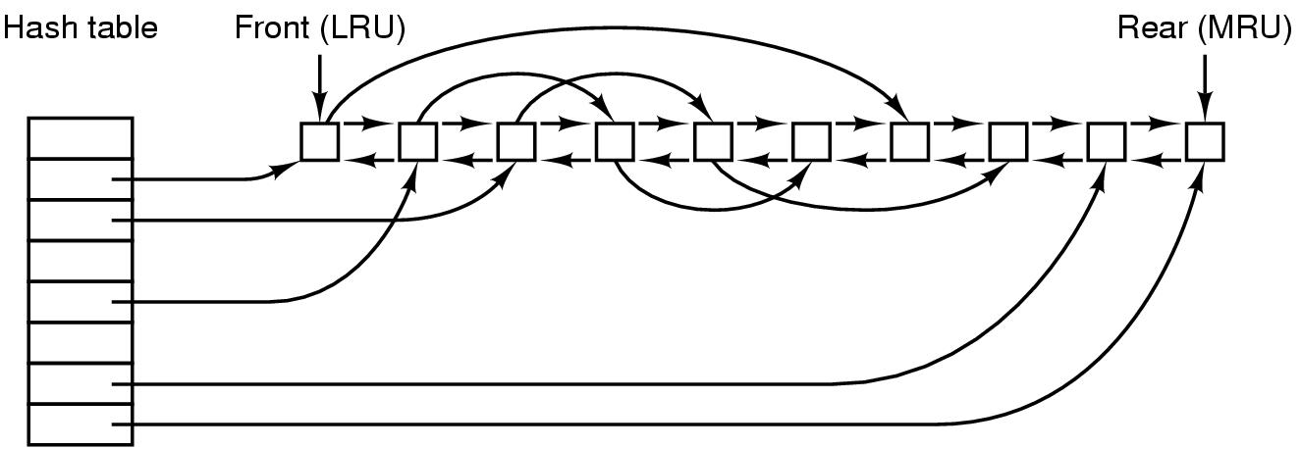
Caching
Hash calculated based on the device and disk address.
The buffer cache data structures.

Slide 44
Caching (2)
Original LRU algorithm is problematic
Some blocks, such as i-node blocks, are rarely referenced two times within a short interval.
Can leave some block in cache for a long time, increasing the risk of file system inconsistency in case of a system crash
Consider a modified LRU scheme, taking two factors into account:
Is the block likely to be needed again soon?
If no, put them at the beginning of the list
Is the block essential to the consistency of the file system?
If yes, write to disk immediately
Risk of keeping data in cache for too long
Write through Cache (Windows system)
Write any modified block immediately to disk
Sync (Linux)/Flushfilebuffers (Windows)

Slide 45
Block Read Ahead
Most files are read sequentially
Can we read ahead?
Keep a bit to keep track of the access pattern
Sequential vs random access

Slide 46
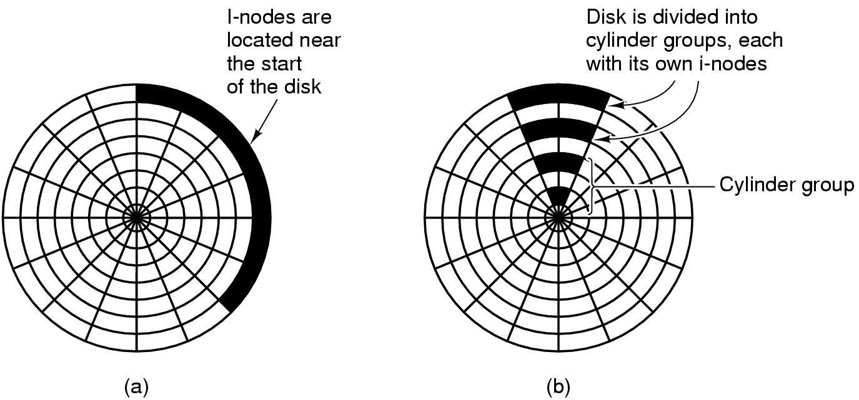
Reducing Disk Arm Motion
Not useful for SSD. Why?
(a) I-nodes placed at the start of the disk. (b) Disk divided into cylinder groups, each with its own blocks and i-nodes.

Slide 47
Defragmentation
Over time, disk usage becomes scattered
Defragmentation
Moves around files

Slide 48
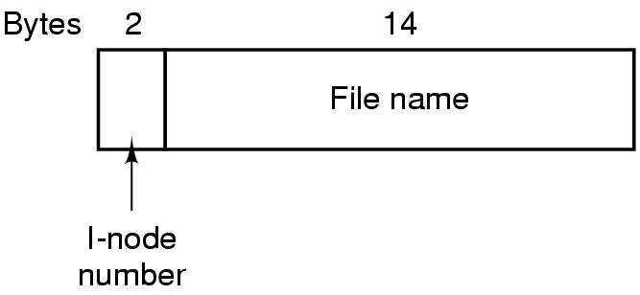
The UNIX V7 File System (1)
A UNIX V7 directory entry.

Slide 49
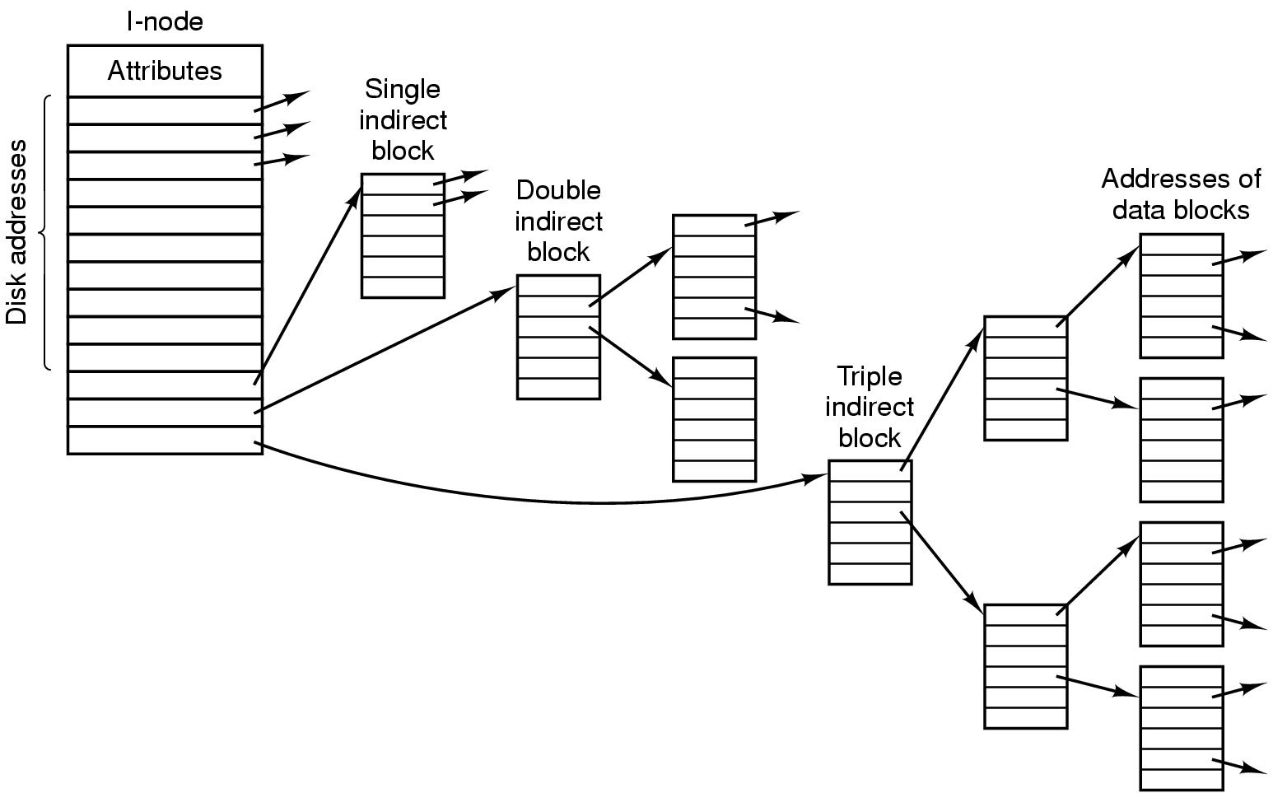
The UNIX V7 File System (2)
A UNIX i-node.

Slide 50
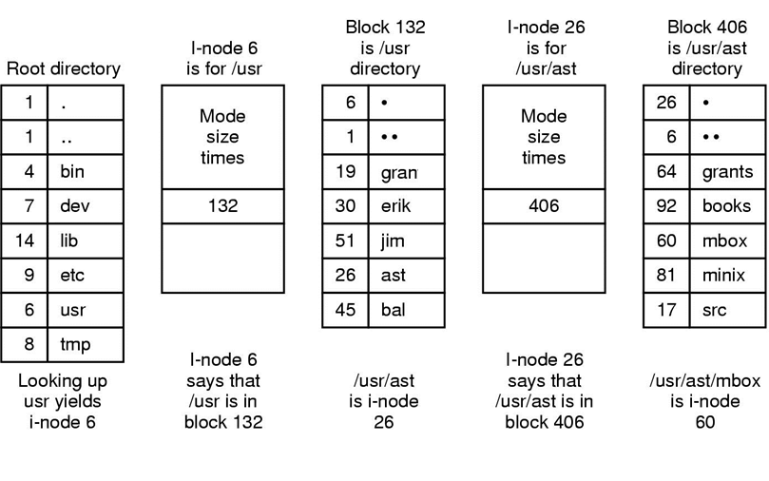
The UNIX V7 File System (3)
The steps in looking up /usr/ast/mbox.

Slide 51
Log Structured File system
Key observation
Most disk accesses are writes, read-ahead does not gain performance
Writes are done in small chunks
The Main idea is to structure the file system as a log
All the pending writes are buffered in memory and written to the disk at the end of the log as a segment
A segment may contain i-nodes, directory blocks, and data blocks
At the beginning of the segment, there is a summary
An i-node map is maintained indexed by i-number. Entry i in the map points to i-node i on the disk
If a file is overwritten, its i-node now points to the new segment
Disk is treated as a circular log
Cleaner thread takes care of fragmentation

Slide 52
Log Structured File system
If a file is overwritten, its i-node now points to the new segment.
Old segment still occupies space!!
Disk is treated as a circular buffer
Cleaner thread takes care of fragmentation by moving valid old segments to the front of the log and removing old ones from the back

Slide 53
Journaling File system
Removing a file
Remove the file from its directory
Release the i-node to the pool of free i-nodes
Return all the disk blocks to the pool of free disk blocks
Log all the operations in a file before actually performing them
All logged operation must be idempotent

